Slide 1
histogram on const mod different cov(x,y)

Slide 2
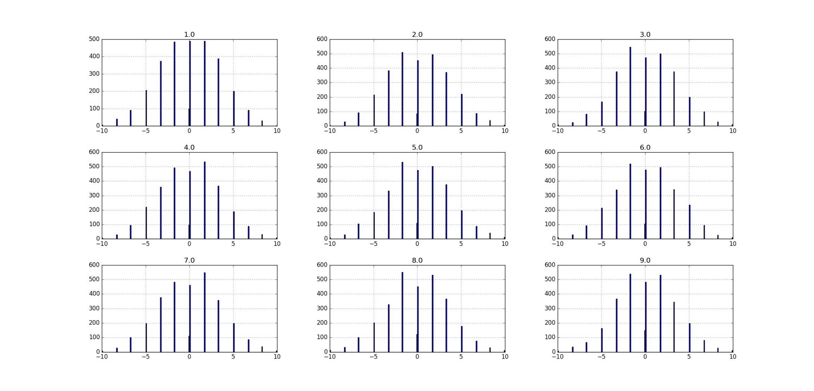
recovered x hist per cov (1-9) at 3 bins mod 5, var(x)=var(y)=10
y is perfectly recovered, we don’t do modulo or quantization on y.
we recover x by y.
each graph has it’s own mse, but we cannot tell which is the best modulo by those graphs

Slide 3
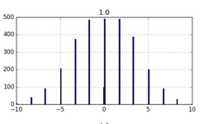
why we get this bell graph also when we have big errors
we get picks at 0, 1.6, 3.2 and 5
we get 3.2 from Ys that are up to 1.6 and from Ys that are above
so each pick can be received from 2 modulo areas
because we have more Ys at the lower modulo area, we get this bell and not like uniform block
we can try to simulate quantizer that is far from the modulo edge – to have a big tails, but I think we will get the same results

Slide 4
x,y before and after A multiplication

Slide 5
eigenvalues of A
if we do SVD on A matrix we decompose A to rotation and scaling
the scaling is by the eigenvectors
integer matrix can have only integer value at the determinant
(we don’t want 0 determinant because we cannot invert the output)
so we actually will get the same or more variance after multiplication at A
so modulo size will have to be bigger (or the same) as the initial X,Y module and we save nothing…

Slide 6
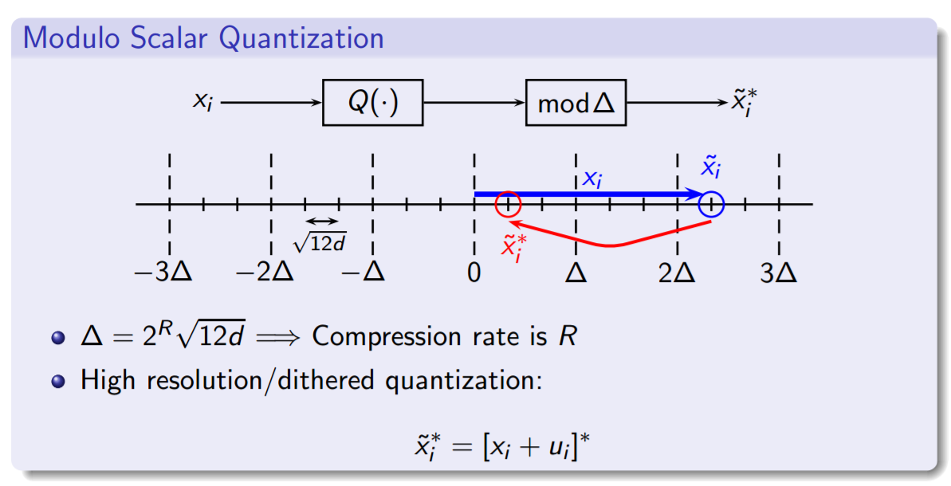
target – get smaller variance of X after A
but we actually have to put here the modulo size to be – let say to 3 delta instead of 1

Slide 7
but we actually get more variance after A
some examples of before – after A:

Slide 8
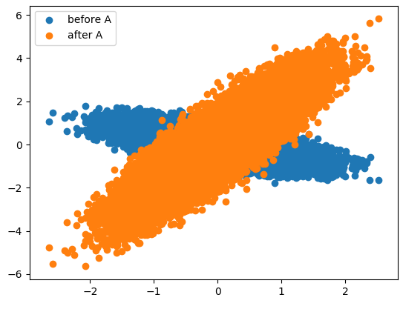
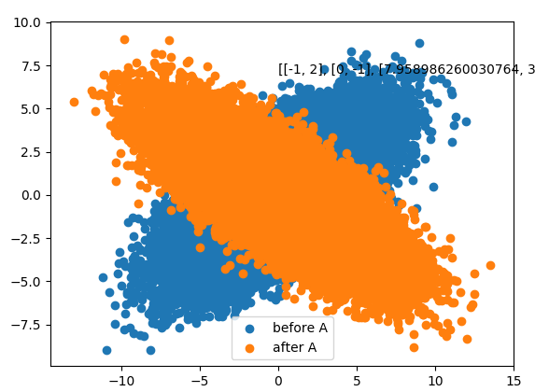
matrix: [[ 1 0] [ 1 -2]] eigenvalues: [-2. 1.] det: -2.0
matrix:
[[-1 2]
[ 0 -1]]
eigenvalues: [-1. -1.]
det: 1.0

Slide 9
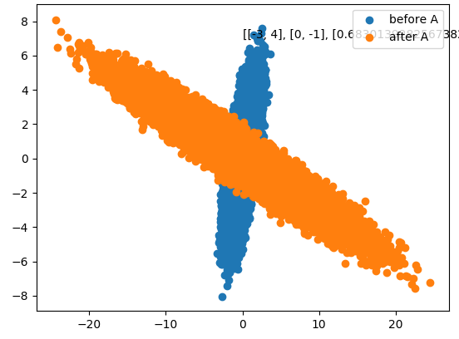
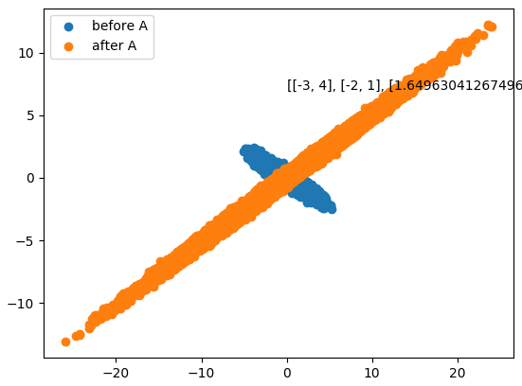
eigenvalues: [-3. -1.] det: 3.0
eigenvalues: [-1.+2.j -1.-2.j]
det: 5.0

